Slide 1
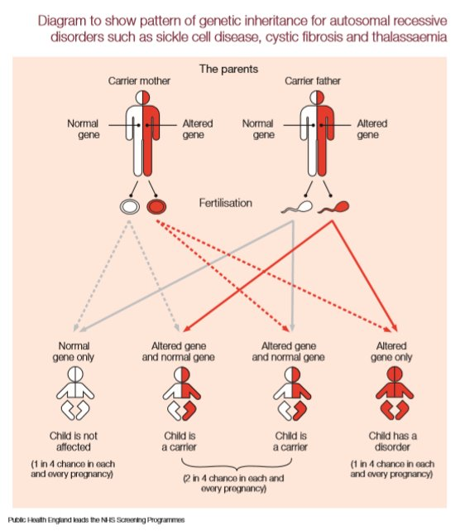
How do persons with Sickle Cell Disorder (SCD) experience understand and explain their employment experiences – A thematic analysis.
(Myrle Blaine Faculty of health and Social Care. University of Derby. M.blaine1@unimail.derby.ac.uk)
Aim
The context of Sickle Cell Disorder (fig 1)
111 Results - Findings
Discussion
To critically explore the employment experiences of persons with SCD in the UK.
To critically assess all aspects of the research study – except the recruitment of participants in order to identify potential flaws.
Category of theme | Evidence from the data
Behaviour | '...I just walked out , I just literally one day , picked up my bags and walked out because I was very very ill'
Emotions | 'I hated her for doing that , insisting that I did her job..I knew if I wanted ...I would have applied... '
Health | '..I knew my body couldn't cope with it'
Inequality
Oppression | '..I prepared from...and she said oh no your not following ...I need you somewhere else' ..' I was supporting all the...and I had my own...and had to take on all the support of all these...'
Self - determination | ' I am going to prove them wrong'
Disability (illness) | 'saying I was sick because the couldn't believe it until one day when the ambulance picked me up at...because I had a major crisis in front of...they said we didn't know you got so bad...but you have been telling us this...they were besides themselves'
Disadvantage | '...should be judged on me on an observation and they couldn’t, have arranged that which meant that I had zero..'
Employment | '..full- time and then part –time when my health became so bad, I there were times I had to go down part – time..'
Lack of knowledge / understanding | 'when I was sick they couldn't understand how come I have these regular illness and I seem perfectly ok other times so there were some discrepancy , I mean some of my colleagues weren't very happy that I was having all that time off'
Discrimination | '...there is nothing wrong with you and I was suppose to get support to return to work , she was adamant that I shouldn't have it'
Prejudice | 'there was so much prejudice and I think part of it was because I was black' ..'the thing is the prejudice was coming from my own people'
Racial - bias | '..I found and I'm not being racist here but I found that the white ...and... were more understanding than a black ...because we had a ...towards the end and the last … were Jamaicans and they gave me hell'.
Attitudes / Stereotypes | 'you are a abled – bodied disabled'
Most studies on SCD focus mainly on psychological and medical aspects of SCD.
The pilot study begins to fill the gap in the research of SCD and employment experiences.
This study found 14 themes. The results suggest persons with SCD experience short spells of employment and experience lack of understanding, racism, oppression, disadvantages, prejudices and racial bias, not particular to this study alone. The results produced rich data but may not be enough to reach an acceptable significant conclusion this needs to be explored further.
Slight tweaking of the interview questions is required and more rigorous larger scale study with increased sample size to produce more conclusive results. A focus on interpretive phenomenology analysis may provide a deeper more in-depth analysis of the lived experiences of persons with SCD and their employment.
How do persons with SCD experience understand and explain their employment experiences – A thematic analysis
Objectives
To critically assess all components of the research study (except the recruitment of participants) and identify any problems.
To make recommendations to improve the effectiveness of the research study components for the Employment experiences of persons with SCD in the UK.
To produce a report summary.
1 Introduction
11 Methods
References
Sickle Cell disorder (SCD) is the most common genetic disorder worldwide and fastest growing(Thein 2017).
A phenomenological perspective was undertaken with a qualitative approach .
Braun, V., and Clarke, V.(2006)'Using Thematic Analysis in Psychology' Qualitive Research in Psychology, 3:77- 101
Franklin, I.M. & Atkin, K. (1986) Employment of Persons with Sickle-Cell Disease and Sickle-Cell Trait. Journal of Occupational Medicine.36, 76-79.
Pedulla,D.S.(2018) 'How race and unemployment shape labor market opportunities : Additive, amplified, or muted effects?' ,Social Forces, 96, (4),pp 1477–1506, https://doi.org/10.1093/sf/soy002
Public Health England (2016) Sickle Cell and Thalassaemia Screening Programme. NHS
Sanger, M., et. al. ( 2016), 'Cognitive deficit are associated with unemployment in adults with sickle cell anaemia' Journal of Clinical and Experimental Neuropsychology, 38(6).pp661 -671. https://doi.org/10.1080/13803395.2016.1149153
Thein, S. (2017). Pioneering Research into Sickle Cell Disease. Kings College hospital. Available at : https://supportkings.org.uk/why/pioneering-research/pioneering-research-into-sickle-cell-disease/ ( Accessed 14/ 6/ 2018 )
More common in those from ; African, Caribbean, Middle Eastern, Mediterranean, south Asian ancestry (Franklin and Atkin 1986).
Interpretive via (1) Audio digital recording (2) Semi– structured interviews which explored employment experiences of 2 adult participants with SCD.
Intersectionality of race, unemployment, disability intersect with each other and shape the ability to obtain a job (Pedulla 2018).
Received a invitation letter, participant information sheet and signed a consent form.
This population face a high chance of being unemployed 60 % of adults are (Sanger et al. 2016).
Analysis via translation of the transcripts and thematic analysis outlined by Braun and Clarke (2006).

